Slide 1

Working to Change the Trajectory of Substance Use and Depression in Virginia
Patty Ferssizidis, PhD
VA-SBIRT Project Manager
Assistant Professor, George Mason University

Slide 2
Overview
Describe
Describe the SBIRT process.
Share
Share outcomes to date.
Discuss
Discuss the role of SBIRT in a comprehensive plan for addressing addiction.

Slide 3

Substance Use Is
A Public Health Problem

Slide 4

A Population-Based Response to Substance Use
  “Where” do we reach the greatest number of people?
  “How” do we identify substance risk?
  “What” do we do to intervene?
  “When” do we intervene?

Slide 5
Identifying a Service Gap
Specialty Substance Use Treatment
Prevention Efforts
???

Slide 6
The SBIRT Model
Screening
Brief Universal Screen
Brief Intervention
Motivational change-based discussion
Brief, 5-10 minutes
Referral to Treatment
Secondary Screen to stratify risk
Alcohol, Drugs, Tobacco, Depression
Active and Collaborative referral practices
On site outpatient therapy (MET/CBT)
Specialty Treatment in the Community
IDENTIFY
INTERVENE
(Mild Risk)
CONNECT
(Moderate & High Risk)

Slide 7
Addressing a Service Gap
Specialty Substance Use Treatment
Prevention Efforts
SBIRT

Slide 8
“Brief interventions are feasible and highly effective components of an overall public health approach to reducing alcohol misuse.”
—Whitlock et al., 2004, for U.S. Preventive Services Task Force

Slide 9

Evidentiary Support
Of 1.5 million screened by SAMHSA-supported programs (SAMHSA GPRA data, 2003-2011),
  40% reduction in harmful use
  55% reduction in negative social consequences
  Positive benefits for reduced illicit substance use
  Reductions in other risky behaviors (injection drug use, unprotected sex)
$3.81 to $5.60 for every dollar spent (Fleming et al., 2000)

Slide 10


Virginia Screening, brief intervention, and referral to treatment Project
$8.3 million SAMHSA grant awarded to DBHDS
Implemented by GMU
11+ practice sites
    EDs
    Free Clinics
    FQHCs
    University Student Health Clinic
    Health Departments
    Family Practice & Urgent Care…Coming Soon!

Slide 11
Substance Risk in Virginia
1%
Severe
2%
Moderate
9%
Mild
88%
Within Normal Levels
Based on Screening of 50,045 Virginians in Shenandoah Valley & Northern Virginia over a period of two years.

Slide 12
 | Substance Use Risk by Site Type
 | Emergency Dept | Primary Care Practice | Clinic for Uninsured | Student Health Service | Health Dept – STI Clinic
High risk | 1% | 0% | 3% | 0% | 1%
Moderate risk | 2% | 1% | 3% | 2% | 6%
Mild risk | 7% | 5% | 17% | 15% | 33%
No/Low risk | 90% | 93% | 77% | 83% | 60%

Slide 13
 | N=47,069 | Brief Intervention N=2,474 | Brief Treatment N=142 | Referral to Tx N=268
Gender | 42% male | 59% male | 50% male | 64% male
Age | 18-24: 18% 25-34: 16% 35-44: 13% 45-54: 14% 55-64: 14% >65: 25% | 18-24: 38% 25-34: 21% 35-44: 13% 45-54: 13% 55-64: 11% >65: 4% | 18-24: 30% 25-34: 22% 35-44: 16% 45-54: 17% 55-64: 14% >65: 1% | 18-24: 11% 25-34: 28% 35-44: 21% 45-54: 21% 55-64: 13% >65: 5%
Ethnicity | 83% non-Hispanic 39% Central Amer 20% Mexican 16% South Amer 6% Puerto Rican 11% Other 1% Cuban 1% Dominican 7% Did not know | 82% non-Hispanic 40% Central Amer 23% Mexican 11% South Amer 9% Puerto Rican 7% Other 2% Cuban 2% Dominican 7% Did not know | 86% non-Hispanic 46% Central Amer 15% Mexican 8% South Amer 8% Puerto Rican 15% Other 0% Cuban 8% Dominican | 91% non-Hispanic 27% Central Amer 18% Mexican 9% South Amer 9% Puerto Rican 18% Other 9% Cuban 0% Dominican 8% Did not know
Race | White: 77% Black or AA: 8% Asian: 4% Amer Ind: 0.4% Native Hawaiian 0.2% | 70% White 17% Black or AA 4.5% Asian 2% Amer Ind 1% Native Hawaiian | 69% White 18% Black or AA 3% Asian 0% Amer Ind 1.4% Native Hawaiian | 85% White 7% Black or AA 0% Asian 0.4% Amer Ind 0.4% Native Hawaiian

Slide 14
 | When people screen positive for past year drug use, what drugs are they using?
 | Emergency Dept | Primary Care Practice | Health Dept - STI | Clinic for Uninsured | Student Health Service
Marijuana | 89% | 91% | 89% | 82% | 100%
Prescription Misuse | 25% | 12% | 17% | 13% | 10%
Other Illegal Drug Use | 16% | 22% | 26% | 23% | 14%

Slide 15
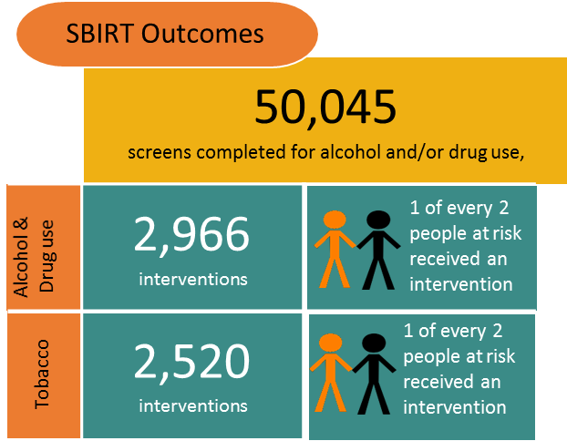

Slide 16
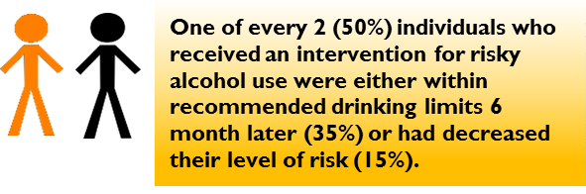
6 months later…

Slide 17
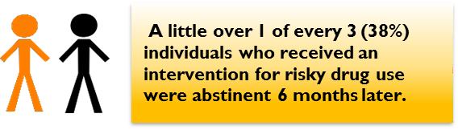
6 months later…

Slide 18
treatment engagement
National Survey on Drug Use & Health – 10.6% who needed treatment actually received it.
    20% engaged in brief treatment in ED, 33% in non-ED setting
    50% engaged in an assertive referral to treatment process across settings

Slide 19
Stories
A woman who I had met with prior, came to the clinic with her cousin. She approached me and said thank you and that our BI had changed her life. She was concerned about her cousin's alcohol use and hoped that I could meet with him as well.

Slide 20
Stories
I had a client drinking 7-8 beers a day that I referred to specialty care last year. He did not follow through on the referral or respond to my follow up at the time. At his rescreen a year later, I learned he had tapered his drinking down to 1-2 binges a month on his own and was also looking to quit cannabis and alcohol altogether. He has enrolled in Brief Treatment and is making progress through outpatient therapy plus SSRI medication to treat anxiety.

Slide 21
Stories
I began seeing a Female Client who had screened in the severe ranges for both alcohol and drugs. The client had been sober for ~4 months when we first met. She had a history of polysubstance abuse, primary substance heroin. Client is 35yo, has been using substances since the age of 16. She is currently in her longest period of sobriety she has ever achieved and will be a year sober on DATE. The client has attended 16 BT sessions and has shown considerable improvement. Client had multiple legal issues that she has since resolved, she is now gainfully employed, still residing in supportive housing. Client has experienced relapses of many of her housemates and her significant other, yet has continued to stay in recovery through the support of her recovery network, including myself.

Slide 22
Stories
John Doe is a 47 year old male who scored in the severe range for alcohol use. He has cirrhosis of the liver, anemia, edema, hypertensive disorder, gastrointestinal hemorrhaging, ulcers, you name it. The alcohol was wreaking havoc on his body. I did 4 BI’s trying to get him into BT (he really needed RT but that was completely off the table for him). Each time, he would make an appointment for BT, and then break the appointment. Finally, one day he had bloodwork done and the results were shocking. His organs were basically failing. Our nurse practitioner called him and told him he needed to go to the emergency room IMMEDIATELY. He ended up being admitted to the hospital for 4 days.
During our BI’s, he was defensive, minimizing, and irritable. He did not want to hear about the damaging effects of alcohol, he really didn’t want to speak to me at all. But some seed must have been planted. After leaving the hospital, he made the decision to stop drinking. When he came for his hospital follow-up, I did another BI. This time, he was very receptive to coming to BT and he kept his first appointment. And his second. And his third. He is thriving, he is still sober, he’s like a totally different person. He was literally on death’s door, he was walking with the assistance of a walker, he was jaundiced, had to wear sunglasses even indoors because his eyes were so sensitive. Now, his skin is clear and rosy, he walks completely fine, he’s losing weight, he’s just overall so much healthier. And this is just six weeks of sobriety. I cannot wait to continue to follow his journey and I know recovery can be a struggle, I know there is the potential for relapse, but this is a true SBIRT success story so far. And I pray with the continued support of myself and everyone here at the clinic, that it remains a success story.

Slide 23
Changing lives one screen at a time…

Slide 24
Thank you on behalf of the va-sbirt team
Patty Ferssizidis, PhD
pzorbas@gmu.edu

